Slide 1

Surgical management of end neuromas
Brian A. Pinsky, MD, FACS
4/22/2020

Slide 2
No disclosures

Slide 3
About me
MD – Case Western Reserve University
Plastic & Reconstructive Surgery – Mt. Sinai
Hand & Microsurgery – UCLA

Slide 4
Overview – Neuroma Mgmt.
Anatomy & Pathophysiology
Diagnosis
Amputees
Surgical Management
    Targeted Muscle Reinnervation (TMR)
    Regenerative Peripheral Nerve Interface (RPNI)
Practice Integration

Slide 5
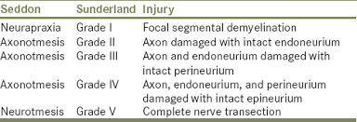
What is a neuroma?
Physiologic response to nerve injury
Distal stump – Wallerian degeneration
Proximal stump – attempt to regenerate towards distal target

Slide 6
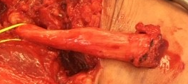
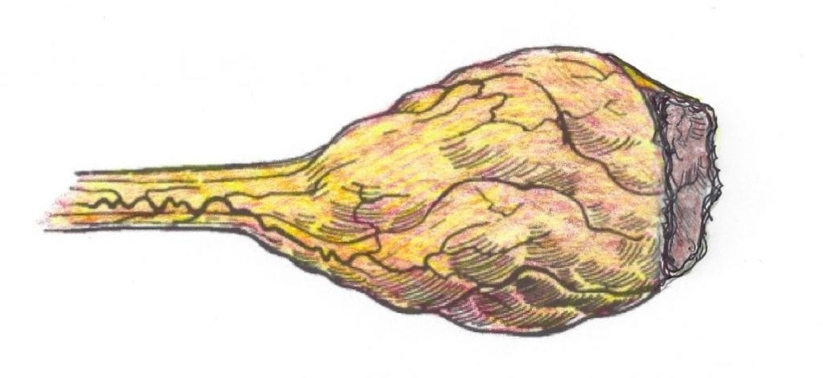
Classic Neuroma definition
Disorganized whirling of large and small nerve fascicles with well myelinated fibers in a dense connective tissue stroma
Sensory or mixed nerves
    Motor nerve do not form symptomatic neuroma

Slide 7
Neuroma types
End neuroma
Neuroma-in-continuity
vs
Complete disruption of nerve fibers
Symptoms can depend on location of the neuroma
Post surgical / post traumatic
  Amputees
Multiple treatment options
Partial nerve injury
More complex treatment algorithm
Treatment depends on the degree of intact function
Occurs at every nerve repair coaptation
    Relevant to secondary reoperation

Slide 8
Neuroma symptoms
Neuropathic pain – sharp or burning
Numbness
Paresthesias/dysesthesias
Cold intolerance
Electrical sensitivity
Can be severe, debilitating, impact QOL, employment, narcotic use…

Slide 9
Diagnosis
Detailed history
Mechanism of trauma (sharp, crush, traction, etc.)
Time course of symptom development
Degree of dysfunction
Prior interventions – surgical history
Goals of treatment
Narcotic use

Slide 10
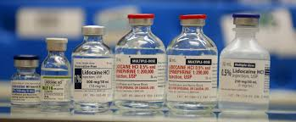
Clinical Diagnosis
Discrete area of tenderness/tinel sign that elicits pain or paresthesias in a defined peripheral nerve distribution
Area of altered sensation (numbness, hypesthesia, hyperalgesia) distal to tinel’s
Defined nerve injury
Positive response to proximal nerve block

Slide 11
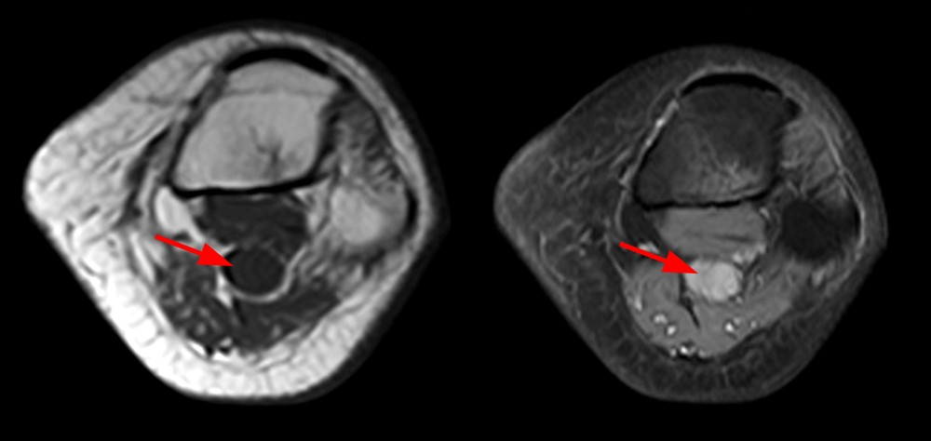
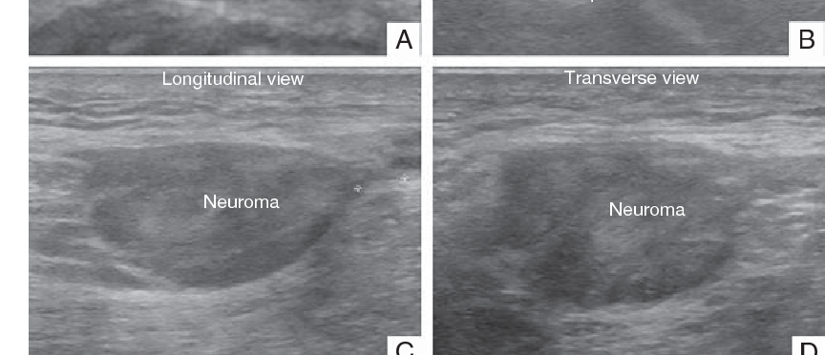
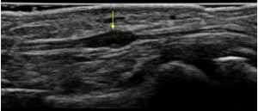
imaging
Helpful but not mandatory in every case
    MRI
    Hi-def Ultrasound

Slide 12
Amputees
> 2 million amputees in US with chronic pain
    Up to 50 % develop symptomatic neuromas
    5-10% disabling pain
    Up to 85% have phantom limb pain (PLP)
End neuroma is the driver of chronic limb pain
Phantom limb pain - complex interplay between painful neuroma and CNS
      Results in cortical reorganization
      More difficult than neuroma pain to prevent or reverse

Slide 13
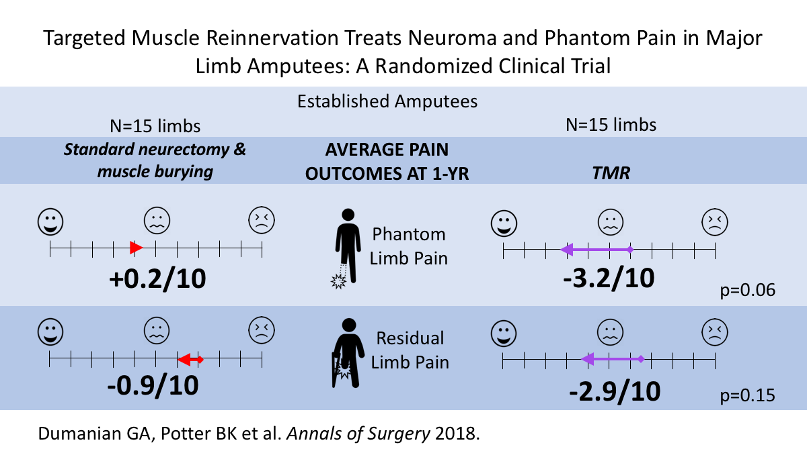
Phantom Limb Pain
Rule of 1/4ths - 25% of established amputees experience SEVERE phantom limb pain, 25% MODERATE, 25% MILD, 25% NONE
TMR decreases chronic PLP in established amputees

Slide 14
Centralized pain
Peripheral pain trigger becomes amplified resulting in changes in the processing of pain signal in the brain and spinal cord
Volume control of painful stimuli involuntarily turned up
    Also associated sx: depression, anxiety, sleep disorder
    “Fibromyalgia”
Surgery helps peripheral pain but not central pain
When does pain become centralized?
    Pain more than 6 mo after amputation is pathologic BUT
    Not sure, 10-20yrs? Maybe less?
    Medical mgmt – Gabapentin, Lyrica, Cymbalta, etc
    Mirror therapy, Cognitive-behavioral therapy
INTERVENE BEFORE THIS HAPPENS

Slide 15
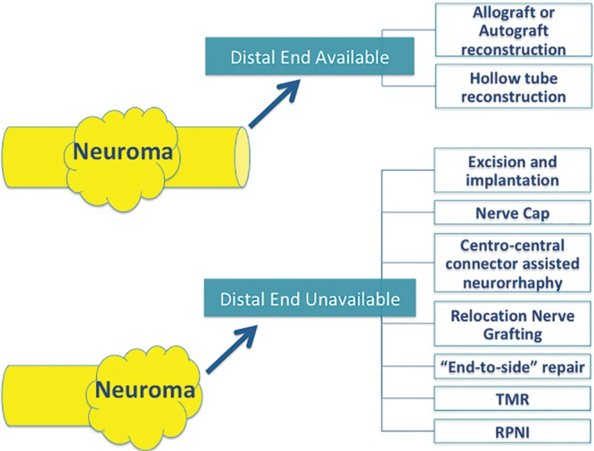
Surgical Management

Slide 16
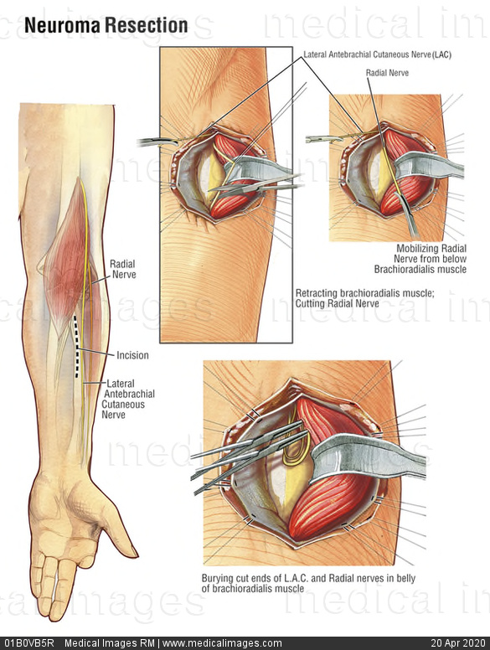
Neuroma surgery
No significant change in neuroma management since early 1980s
Previous “Gold Standard”
Mackinnon & Dellon 1985 – Bury nerve stump into muscle
    “Passive approach” – translocates the neuroma, does not address regenerative potential of proximal stump or provide neuroma-free path
    Attempt to bring neuroma to better microenvironment (vascularized, innervated muscle)
    Initial study with 82% good + excellent results, not as consistent in actual practice

Slide 17
Targeted Muscle Reinnervation
First described by Dumanian in 2002 to improve the intuitive control of myoelectric prostheses
“active” treatment after neuroma excision to satisfy need for physiologic regeneration
Give the nerve somewhere to go and something to do

Slide 18
TMR
Denervated target is key!
Some motor fascicles reach MEP and reinnervate denervated muscle
Sensory fibers reach proprioceptors, etc
Establishes a new afferent signal and closes afferent-efferent feedback loop
No function lost - target muscles are functionless after amputation

Slide 19
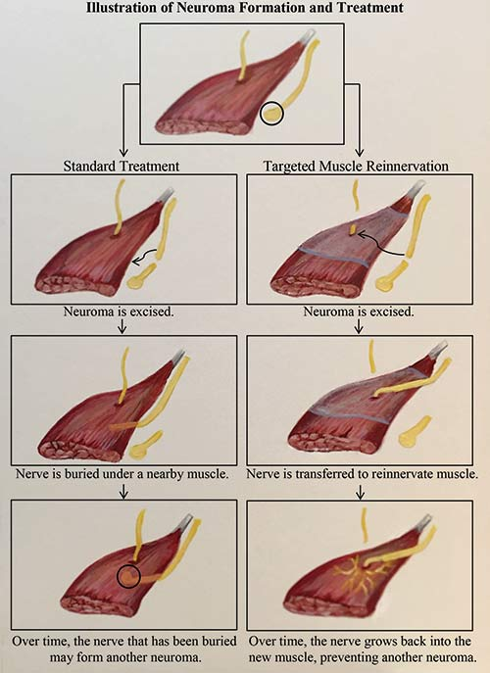
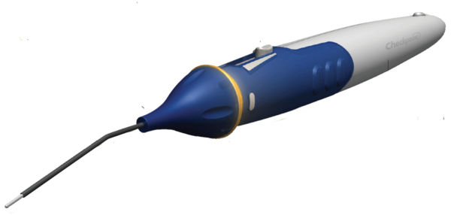
TMR Technique
Neuroma excised to healthy fascicles
Smaller motor nerve target identified with handheld nerve stimulator
Major nerve coapted tension-free to distal segment of small motor branch with 6-0/7-0/8-0 sutures
    Muscle cuff for size mismatch
    Fibrin glue
Loupe magnification

Slide 20
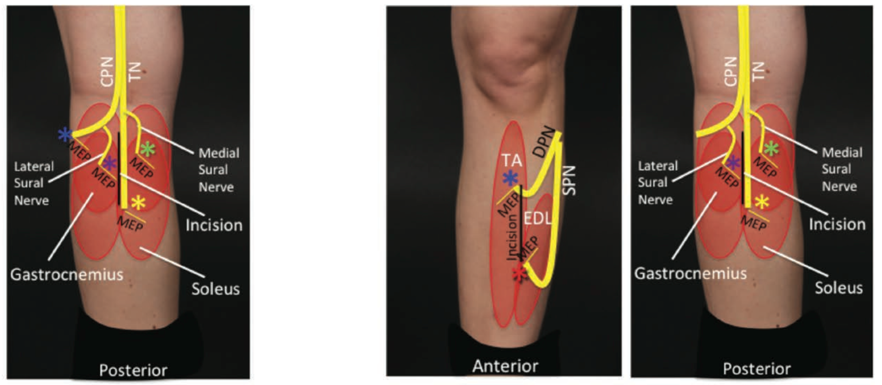
Table 2. BKA delayed (prone, 1-incision approach, posterior midline only)
Nerve | Primary targeted muscles | Lower Leg Compartment
COMMON peroneal, Possible sparing of motor to TA | Lateral gastrocnemius | Superficial posterior
Tibial | Flexor hallucis longus | Deep posterior
Medial sural | Soleus, or Medial gastrocnemius | Superficial posterior
Lateral sural | Lateral gastrocnemius | Superficial posterior
Table 4. AKA (supine to prone; posterior midline, junction of proximal and middle third)
Nerve | Primary targeted muscles
Saphenous | Vastus medialis
Peroneal component of sciatic | Biceps femoris
Tibial component of sciatic | Semitendinosis or Semimembranosis
Posterior femoral cutaneous | Biceps femoris (distal motor branch)

Slide 21
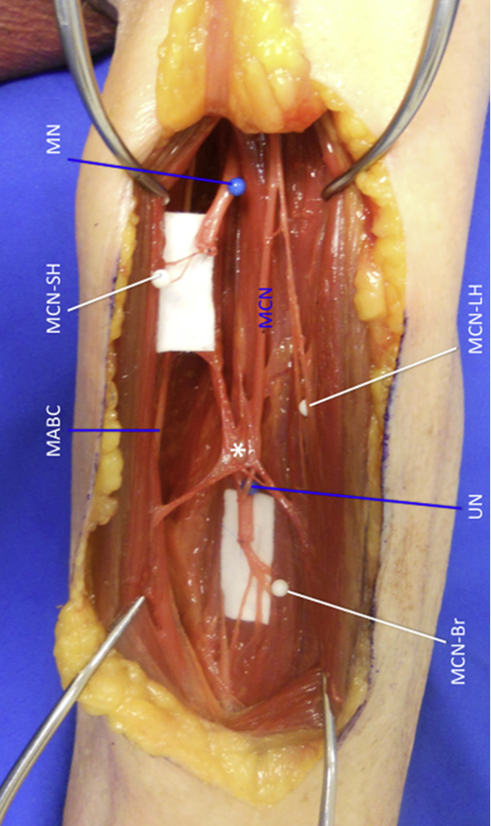
Transhumeral nerve transfers (anterior and posterior midline incisions)
Nerve | Primary targeted muscles
Median | Medial head of biceps
Ulnar | Brachialis
Radial | Lateral head of triceps
MABC/ LABC | Any nearby

Slide 22
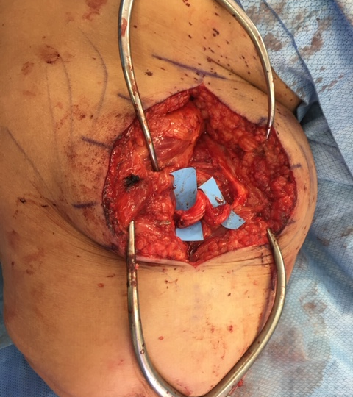

Case 1

Slide 23
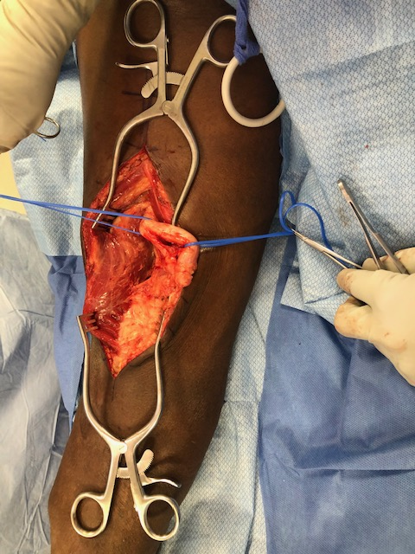
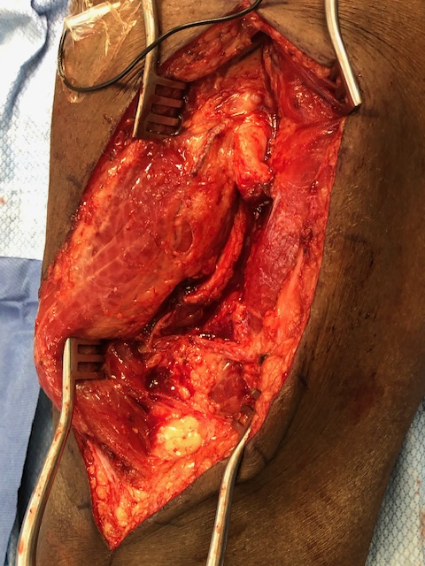
Case 2

Slide 24
TMR
Indications
COntraindications
Almost any end neuroma
Any amputee desiring better prosthetic function
Reduce neuroma pain
Better results in traumatic/oncologic amputees
Age not a contraindication
Can be done acute, subacute, or chronic
    Best to do before chronic pain become centralized ~ 6 mo
    Subacute may be logistically easier
Severe comorbidities
Lack of available target motor fascicles
Diabetic vasculopath (relative)
Chronic limb pain for > 10-20 yrs

Slide 25
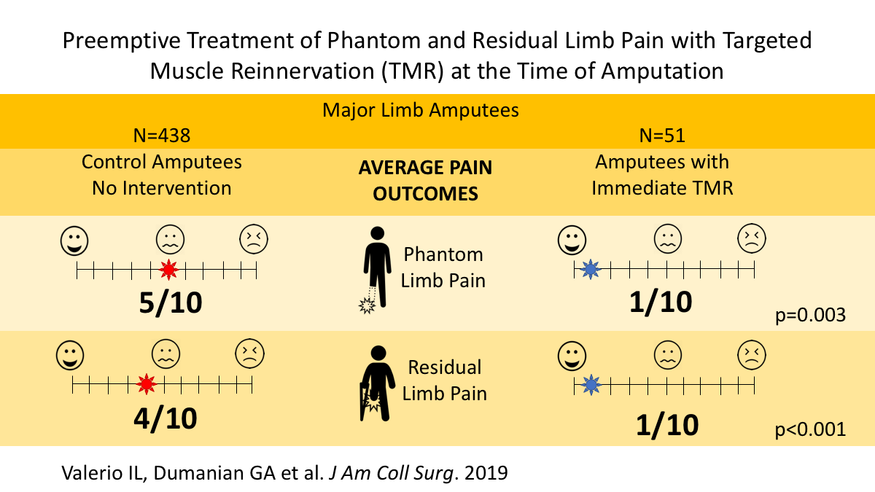
TMR Outcomes
Expect increase in neuropathic or phantom pains for 2-3 months post-op
    Gabapentin, Pregabalin
    Slowly fades over time
Chronic cases - Goal is for improvement, not elimination of neuroma pain
    Increase prosthetic use, decr pain meds, improve function and QOL
Acute TMR at time of amputation reduces the odds of more severe residual limb and phantom limb pain by 3.9 and 3.0-fold, respectively

Slide 26
Regenerativeperipheral nerve interface (rpni)
Cederna - U of Michigan
“Active” technique initially designed to improve intuitive control of myoelectric prosthesis
Animal studies show absence of neuroma formation and clinical studies show decrease in chronic limb pains and phantom limb pins

Slide 27
RPNI
Transected nerve stump placed within free, nonvascularized muscle graft
Graft ~ 30x15x5mm
Nerve secured along axis of muscle fibers
Construct buried remote from surgical incision and away from weight-bearing surface
Larger nerve dissected into fascicular bundles

Slide 28
RPNI
Provides distal physiologic target for axons to make new neuromuscular junctions
    Central feedback loop
    Prevents aberrant axonal growth
Denervated muscle graft becomes regenerated and revascularized with axonal sprouting from implanted nerve
PROS: Easier, no microsurgery
CONS: No target for sensory axons

Slide 29
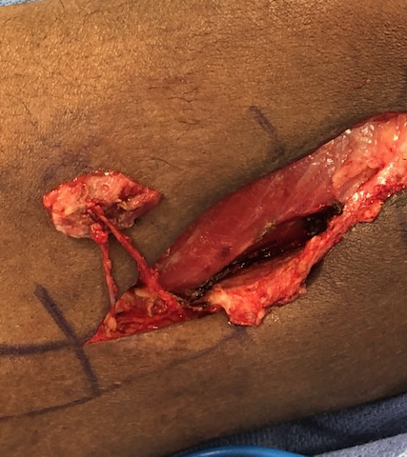
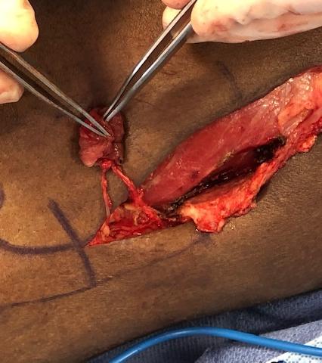
Case 1

Slide 30
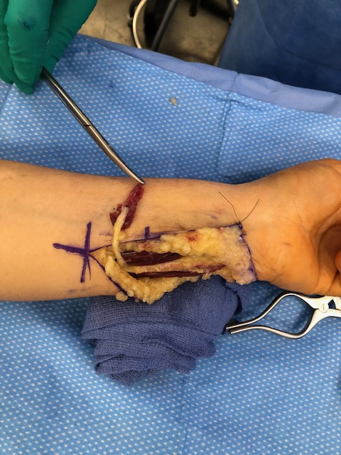
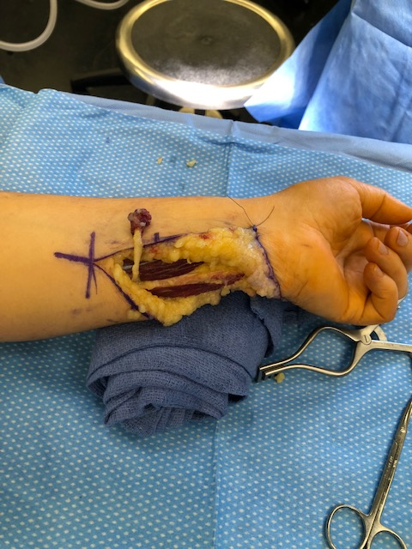
Case 2

Slide 31
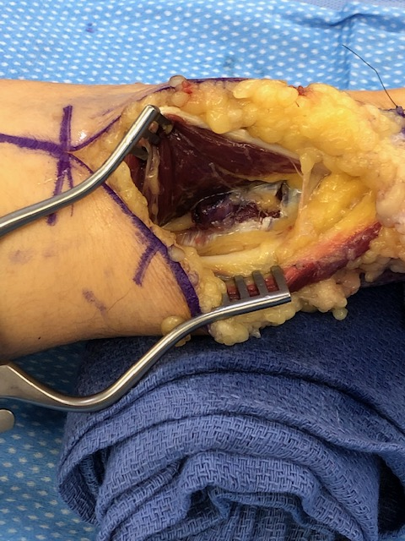
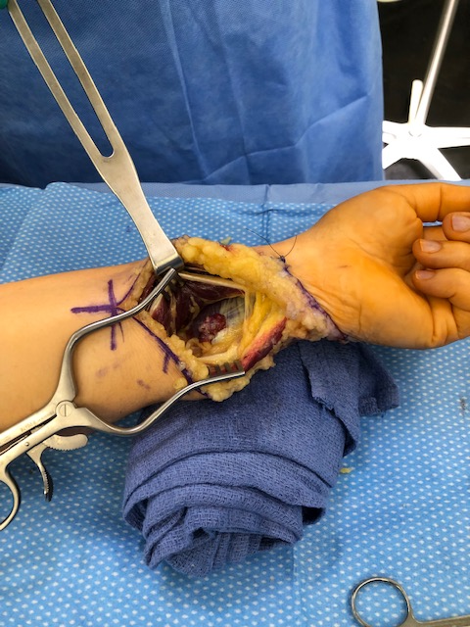
Case 2

Slide 32
How do I add this to my practice?
Key is to understand patient flow
Build strategic relationships with potential referring docs
    Ortho trauma, Ortho oncology, Neurosurgery, Vascular, PM&R
    Prosthetists
Direct patient marketing – support groups, message boards
Logistics – do you want to do at time of amputation vs. subacute

Slide 33
References
Gart et al. Targeted Muscle Reinnervation in the Upper Extremity Amputee: A technical Roadmap. JHS 2015: 40(9): 1877-88.
Fracol et al. Targeted Muscle Reinnervation in the Lower Extremity: An Anatomical Study. PRS 142: 541e, 2018.
Dumanian et al. Targeted Muscle Reinnervation Treats Neuroma and Phantom Pain in Major Limb Amputees. Annals of Surgery 2018.
Kubiak et al. Prophylactic Regenerative Peripheral Nerve Interfaces to Prevent Postamputation Pain. PRS 144: 421e, 2019.

Slide 34
Thank You

