Slide 1

Nerve repair and Neuroma
Brian A. Pinsky, MD, FACS
Institute for Hand Surgery
Long Island Plastic Surgical Group, PC

Slide 2
About Me
MD – Case Western Reserve University
Plastic & Reconstructive Surgery – Mt. Sinai Hospital
Hand & Microsurgery - UCLA

Slide 3
No Disclosures

Slide 4
Overview
Basic nerve anatomy and physiology
Pathophysiology of nerve injury
Repair techniques and outcomes
Nerve reconstruction
Management of end neuromas

Slide 5
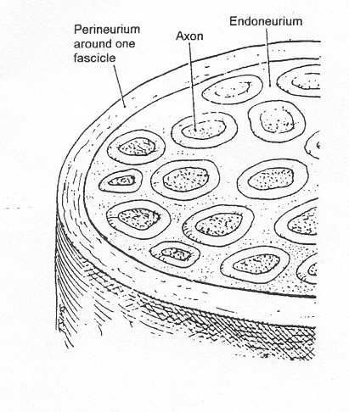
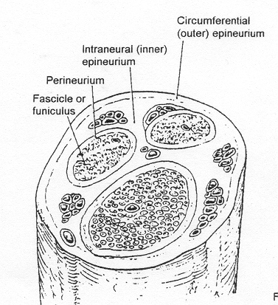
Basic Nerve Facts
Anatomy
  Endoneurium
    Connective tissue surrounding individual axons
  Fascicles
    Groups of axons
  Perineurium
    Surrounds individual fascicles
    Tensile strength and elasticity
    Extension of blood:brain barrier
  Epineurium
    Intraneural(inner)
      Cushion from external pressure
    Outer circumferential

Slide 6
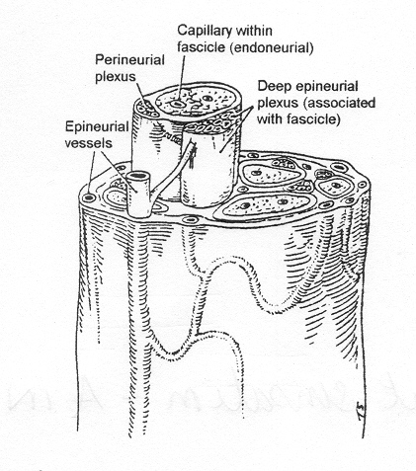
Basic Nerve Facts
  Vascular supply
    Arteriae nervorum (extrinsic)
      Runs w/in loose connective tissue surrounding the nerve
      Enter nerve segmentally
      Divide into longitudinal superficial and interfascicular arterioles
    Longitudinal epineurial, perineueuria, endoneurial vessels (intrinsic)
        ALLOW FOR INTRANEURAL DISSECTION FOR FASCICULAR REPAIR

Slide 7
Nerve Physiology
  Peripheral nerve signaling
    Action potentials
      Unmyelinated fibers
        Rate of conduction directly proportional to cross section of axon
      Myelinated fibers
        Impulse jumps from each site of interrupted myelin sheath (Node of Ranvier)
        SALTATORY CONDUCTION

Slide 8
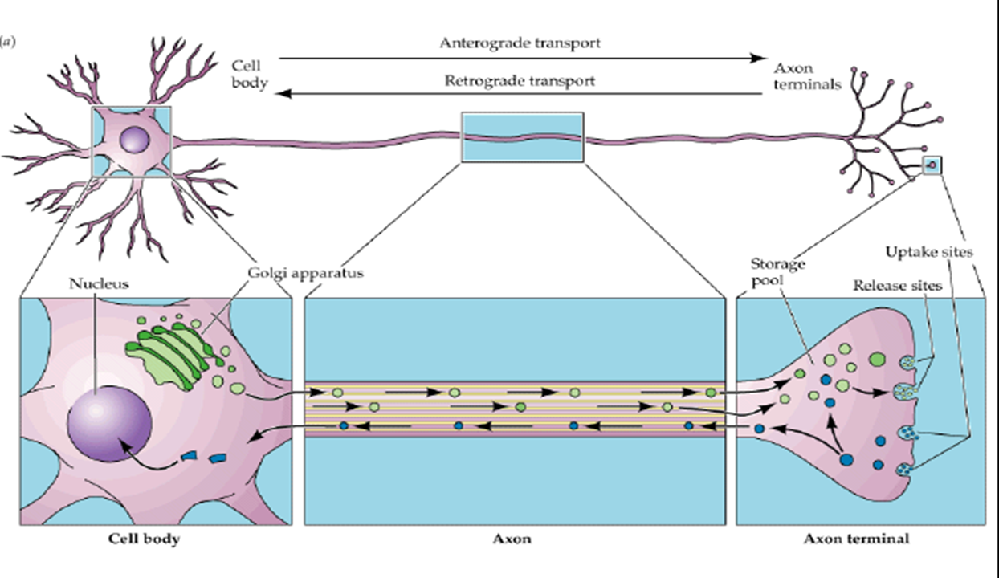
Nerve Physiology
  Peripheral nerve transport mechanism
    Nutrient production
    Axoplasmic transport systems
    Breakdown products
      retrograde axoplasmic transport
    Trauma/infection/compression results in disruption or impairment of transport systems

Slide 9
Nerve Injury
  Two classification systems
    Seddon
      Neuropraxia, axonotomesis, neurotmesis
      Based on clinical evaluation and judgment of injury
      Preoperative assessment
    Sunderland
      1st to 5th degree
      Histology
      Applicable after nerve exploration

Slide 10
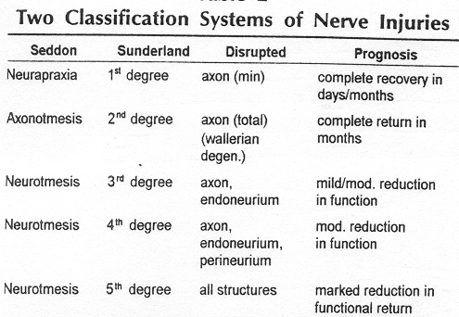

Slide 11
Nerve Repair
  Timing
    Functional results of primary and early secondary nerve repair similar
    Primary repair generally preferred if:
      Proximal injuries
      Operate w/in 72 hours?
      Identifiable nerve ends
      Minimal contamination
      Without associated injuries
      Healthy patient
      Trained surgeon
      TENSION FREE REPAIR!!
    Delayed primary repair within 7 days

Slide 12
Basic Nerve Facts
Nerve repair
  Patient age
    Younger patient
      Better functional outcome
      Optimal recovery in less than 20 years of age
        Motor/sensory nerve
      Digital nerve repairs
        Good results up to 50 years of age
  Condition of the wound
    Increased intraneural damage with extensive injuries

Slide 13
Basic Nerve Facts
Nerve repair
  Level of Injury
    More proximal injury
      Worse functional return (distance to target organ/motor end plate)
  Tension of repair
    Elasticity of neural tissues
    Elongation by 10-15% will impair circulation and cause fibrosis
      After this point nerve conductivity diminishes
  Gap size
    Worse results with gap > 2.5 cm
    Very poor results with gap > 5cm
    Bridge with grafting (autograft or allograft), neurotization

Slide 14
Basic Nerve Facts
Nerve repair
  Technique
    Precise match of motor and sensory fascicles
    No significant difference in outcome by type of repair
      Epineurial
      Perineurial
      Group Fascicular

Slide 15
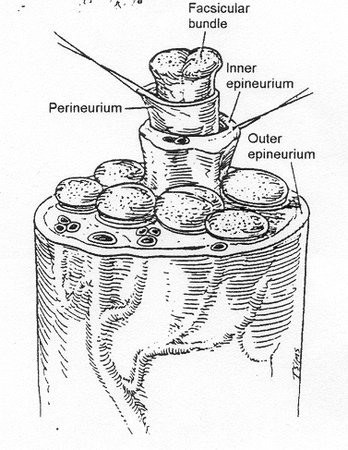
Nerve repair Types
Anatomy
  Epineurial repair
    Outer epineurium sutured
  Fascicular bundle and perineurial repair
    Inner epineurium repaired
  Fascicular repair
    Perineurium sutured

Slide 16
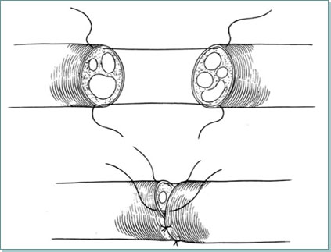
Nerve Repair Techniques
Epineurial repair - single layer repair of epineurium only w/ 8-0 or 9-0 nylon suture
  Smaller diameter sensory nerves
  Larger mixed nerves when sensory/motor fascicle identification not possible (prox limb)
  Well-aligned acute injuries in mixed nerves
  Can be augmented with fibrin glue or conduit

Slide 17
Epineurial Repair
advantages
disadvantages
        Shorter execution time
        Less technically demanding
        Minimal magnification (3.5x loupes)
        Intraneural contents undisrupted
        Imprecise alignment
        Performance by poorly trained personnel

Slide 18
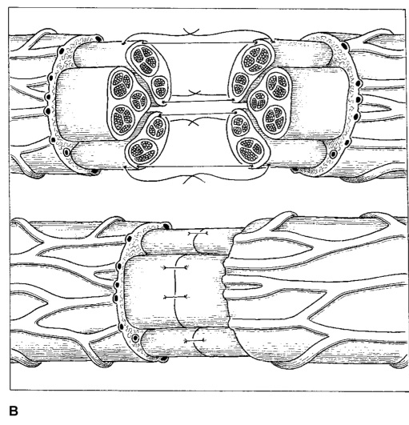
Group Fascicular Repair
Repair of individual motor and sensory fascicular groups with internal/external epineurial sutures
  Fascicular groups identified w/ stimulation (w/in 72h) or direct inspection
  Only use with clear identification of motor and sensory groups
  NO CLEAR BENEFIT of group fascicular repair vs. epineurial repair, may be counterproductive

Slide 19
Group Fascicular Repair
Advantages
DIsadvatages
Technique of choice in nerve grafting
Best in nerves with fewer than 5 fascicles
Better fascicular alignment
More axons entering endoneurial tubes
        Longer operative time
        More technically demanding
        Increased fibrosis at suture site
        Vascular compromise of fascicles/axons
        Trauma to nerve

Slide 20
Nerve Graft
Indicated when >10% elongation of nerve required to bridge gap
  Gaps > 5mm
  Or if single 9-0 suture does not hold with limb positioning
Ischemia of nerve end with 15% elongation
  Recommended for gaps > 2 cm
  Interfascicular technique
  Best recovery if grafting performed between 6-12 months postinjury
Autograft vs. Allograft vs Conduit
  Donor nerves: sural/MABC/LABS/obturator (motor)/spare parts
  Processes nerve allograft (Axogen)

Slide 21
Nerve Repair Outcomes
Meta-analysis PRS 2005
    23 articles, 623 nerve injuries
Factor influencing outcome:
  Age, delay to repair, site, and type of nerve injury
Satisfactory sensory outcome (>= S3+) 42.6%
Satisfactory motor outcome (>= M4) 51.6%
Motor and sensory outcomes correlated

Slide 22
Outcomes (continued)
Younger pts (16 under) - 4x incr chance of satisfactory recovery
  Age <12 at time of injury better subjective outcome (ie satisfaction, effect on profession, hobbies, etc)
Higher lesions and longer delay assoc with poor outcomes
Ulnar nerve repair 71% lower chance of motor recovery than median nerve

Slide 23
Outcomes
Outcomes after peripheral nerve repair improve up to 5 yrs post injury
    CNS adaptability and plasticity

Slide 24
Nerve Transfers
Motor nerve transfers of expendable donor nerve close to motor end plate
  Minimizes time to reinnervation
  Donor and recipient synergy
Transfer of non-essential purely sensory nerve
Post-op motor or sensory re-education essential

Slide 25
Nerve Transfer Indications
Proximal peripheral nerve injuries or brachial plexus injuries when prox stump unavailable or too far to expect meaningful recovery
Avoid areas of severe scarring
Delayed presentation

Slide 26
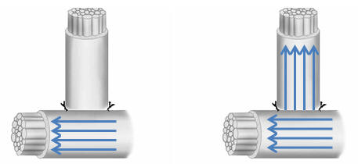
End:Side Neurorrhaphy
Useful with long nerve gaps and proximal injuries
Avoids donor deficit
Sensory nerves exhibit collateral sprouting of axons w/o previous injury; motor nerve require deliberate axonal injury
Axons sprout from closest prox Node of Ranvier
+/- perineurial window

Slide 27
Transfers for ulnar nerve
Motor donor: Anterior Interosseous Nerve
  75% axon count of deep motor br.
  Minimal donor deficit
  Initially described using end:end anastamosis
  Reliable anti-claw procedure
  Does NOT restore normal intrinsic fctn or power pinch
  Must be w/in 6 mo of nerve injury
  Add side:side tenodesis for FDP and power grip

Slide 28
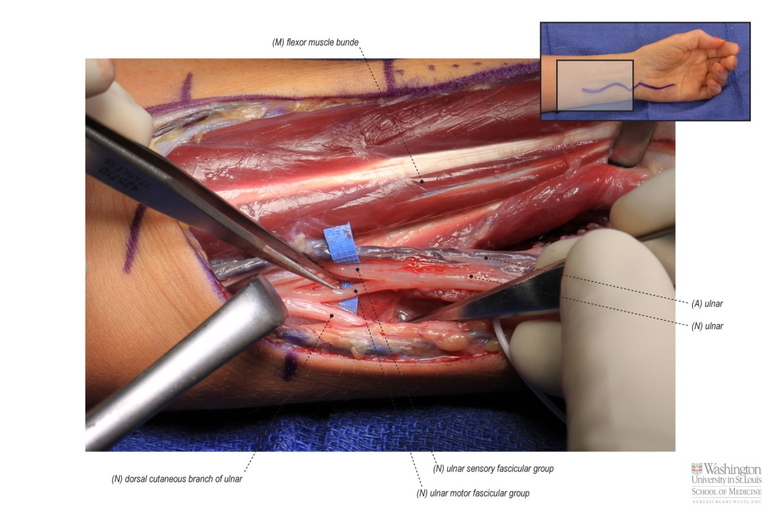
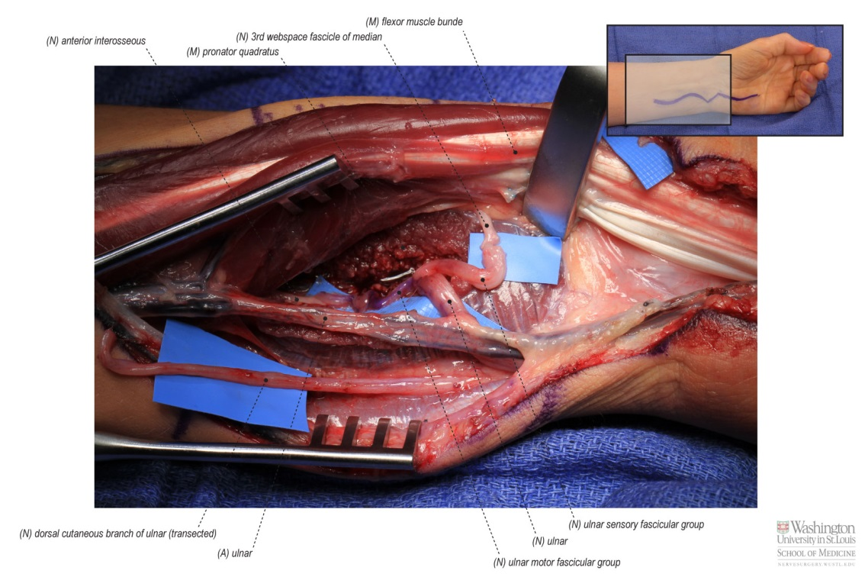
Reverse End:Side AIN Transfer

Slide 29
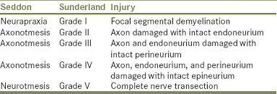
What is a neuroma?
Physiologic response to nerve injury
Distal stump – Wallerian degeneration
Proximal stump – attempt to regenerate towards distal target

Slide 30
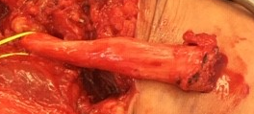
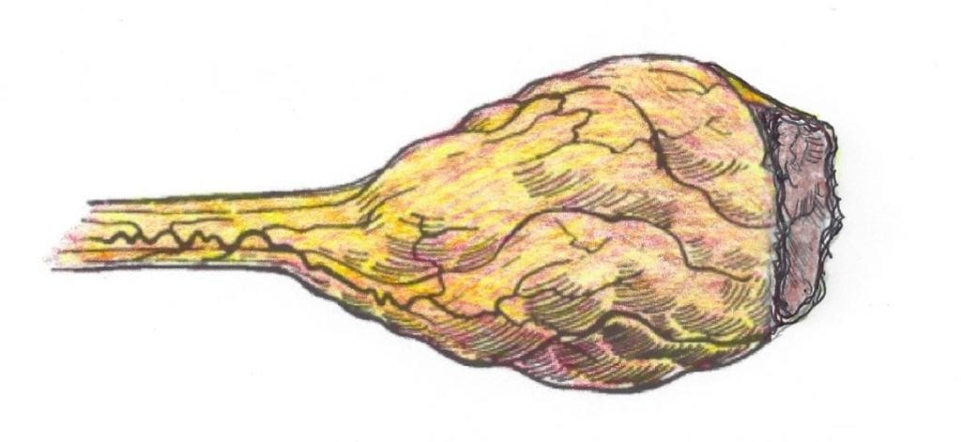
Classic Neuroma definition
Disorganized whirling of large and small nerve fascicles with well myelinated fibers in a dense connective tissue stroma
Sensory or mixed nerves
    Motor nerve do not form symptomatic neuroma

Slide 31
Neuroma types
End neuroma
Neuroma-in-continuity
vs
Complete disruption of nerve fibers
Symptoms can depend on location of the neuroma
Post surgical / post traumatic
  Amputees
Multiple treatment options
Partial nerve injury
More complex treatment algorithm
Treatment depends on the degree of intact function
Occurs at every nerve repair coaptation
    Relevant to secondary reoperation

Slide 32
Neuroma symptoms
Neuropathic pain – sharp or burning
Numbness
Paresthesias/dysesthesias
Cold intolerance
Electrical sensitivity
Can be severe, debilitating, impact QOL, employment, narcotic use…

Slide 33
Diagnosis
Detailed history
Mechanism of trauma (sharp, crush, traction, etc.)
Time course of symptom development
Degree of dysfunction
Prior interventions – surgical history
Goals of treatment
Narcotic use

Slide 34
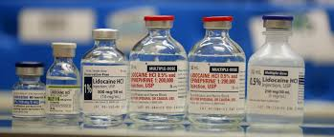
Clinical Diagnosis
Discrete area of tenderness/tinel sign that elicits pain or paresthesias in a defined peripheral nerve distribution
Area of altered sensation (numbness, hypesthesia, hyperalgesia) distal to tinel’s
Defined nerve injury
Positive response to proximal nerve block

Slide 35
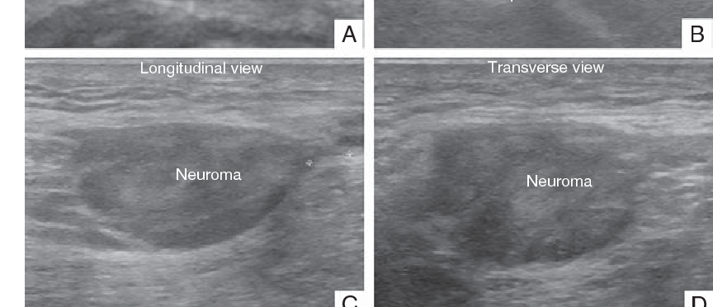
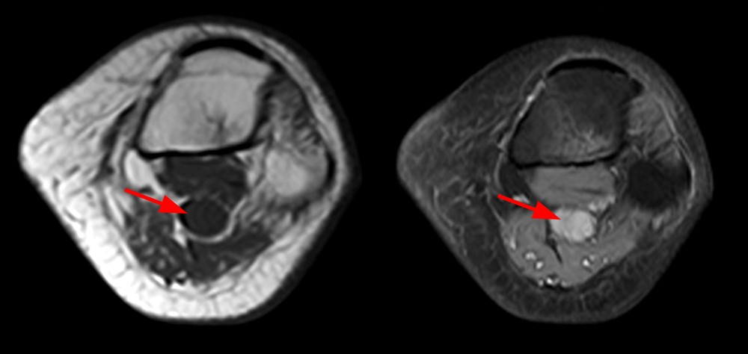
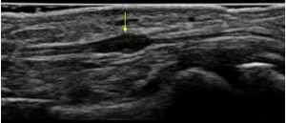
imaging
Helpful but not mandatory in every case
    MRI
    Hi-def Ultrasound

Slide 36
Amputees
> 2 million amputees in US with chronic pain
    Up to 50 % develop symptomatic neuromas
    5-10% disabling pain
    Up to 85% have phantom limb pain (PLP)
End neuroma is the driver of chronic limb pain
Phantom limb pain - complex interplay between painful neuroma and CNS
      Results in cortical reorganization
      More difficult than neuroma pain to prevent or reverse

Slide 37
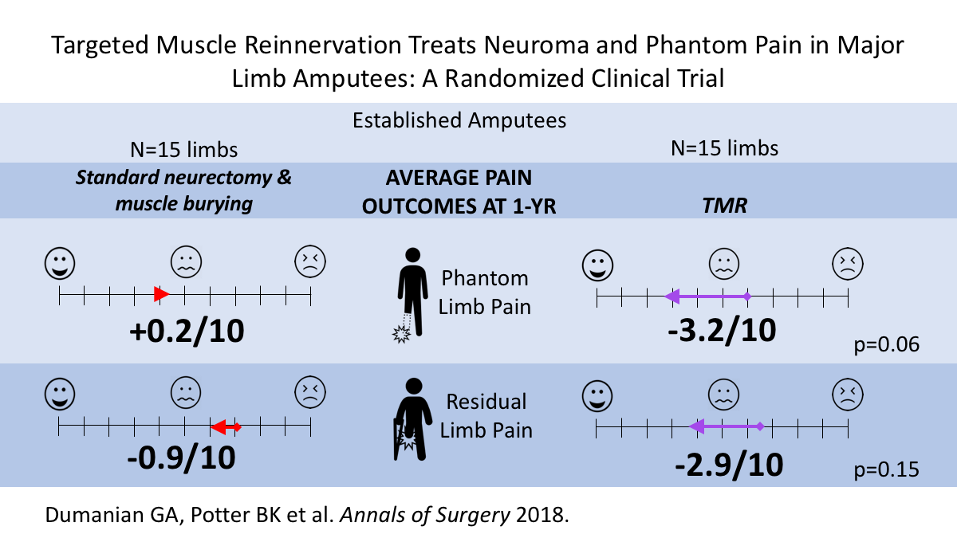
Phantom Limb Pain
Rule of 1/4ths - 25% of established amputees experience SEVERE phantom limb pain, 25% MODERATE, 25% MILD, 25% NONE
TMR decreases chronic PLP in established amputees

Slide 38
Centralized pain
Peripheral pain trigger becomes amplified resulting in changes in the processing of pain signal in the brain and spinal cord
Volume control of painful stimuli involuntarily turned up
    Also associated sx: depression, anxiety, sleep disorder
    “Fibromyalgia”
Surgery helps peripheral pain but not central pain
When does pain become centralized?
    Pain more than 6 mo after amputation is pathologic BUT
    Not sure, 10-20yrs? Maybe less?
    Medical mgmt – Gabapentin, Lyrica, Cymbalta, etc
    Mirror therapy, Cognitive-behavioral therapy
INTERVENE BEFORE THIS HAPPENS

Slide 39
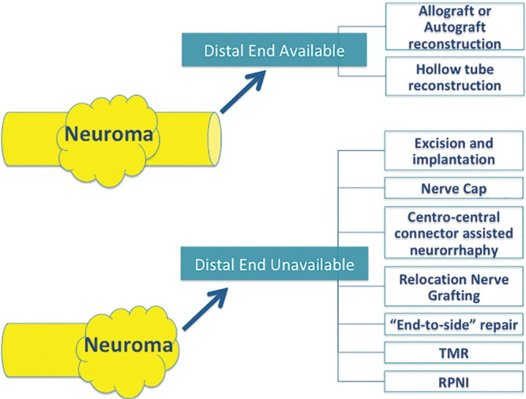
Surgical Management

Slide 40
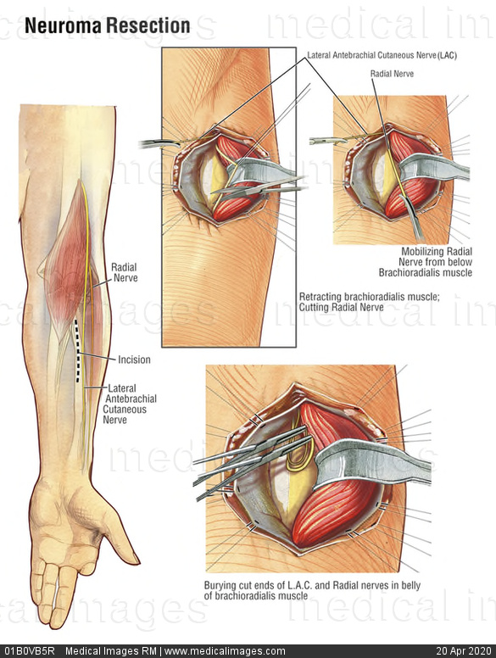
Neuroma surgery
No significant change in neuroma management since early 1980s
Previous “Gold Standard”
Mackinnon & Dellon 1985 – Bury nerve stump into muscle
    “Passive approach” – translocates the neuroma, does not address regenerative potential of proximal stump or provide neuroma-free path
    Attempt to bring neuroma to better microenvironment (vascularized, innervated muscle)
    Initial study with 82% good + excellent results, not as consistent in actual practice

Slide 41
Targeted Muscle Reinnervation
First described by Dumanian in 2002 to improve the intuitive control of myoelectric prostheses
“active” treatment after neuroma excision to satisfy need for physiologic regeneration
Give the nerve somewhere to go and something to do

Slide 42
TMR
Denervated target is key!
Some motor fascicles reach MEP and reinnervate denervated muscle
Sensory fibers reach proprioceptors, etc
Establishes a new afferent signal and closes afferent-efferent feedback loop
No function lost - target muscles are functionless after amputation

Slide 43
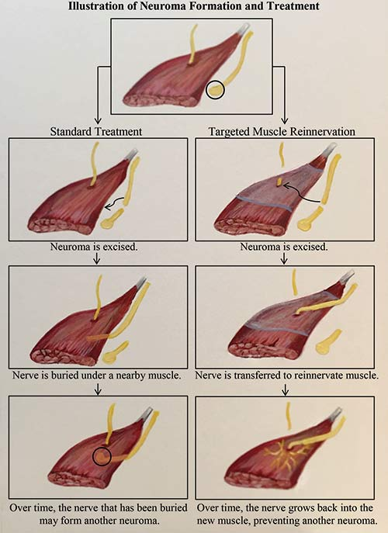
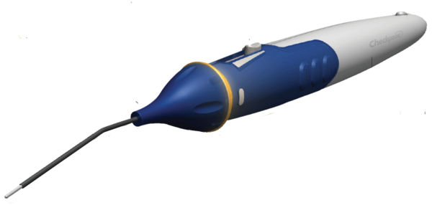
TMR Technique
Neuroma excised to healthy fascicles
Smaller motor nerve target identified with handheld nerve stimulator
Major nerve coapted tension-free to distal segment of small motor branch with 6-0/7-0/8-0 sutures
    Muscle cuff for size mismatch
    Fibrin glue
Loupe magnification

Slide 44
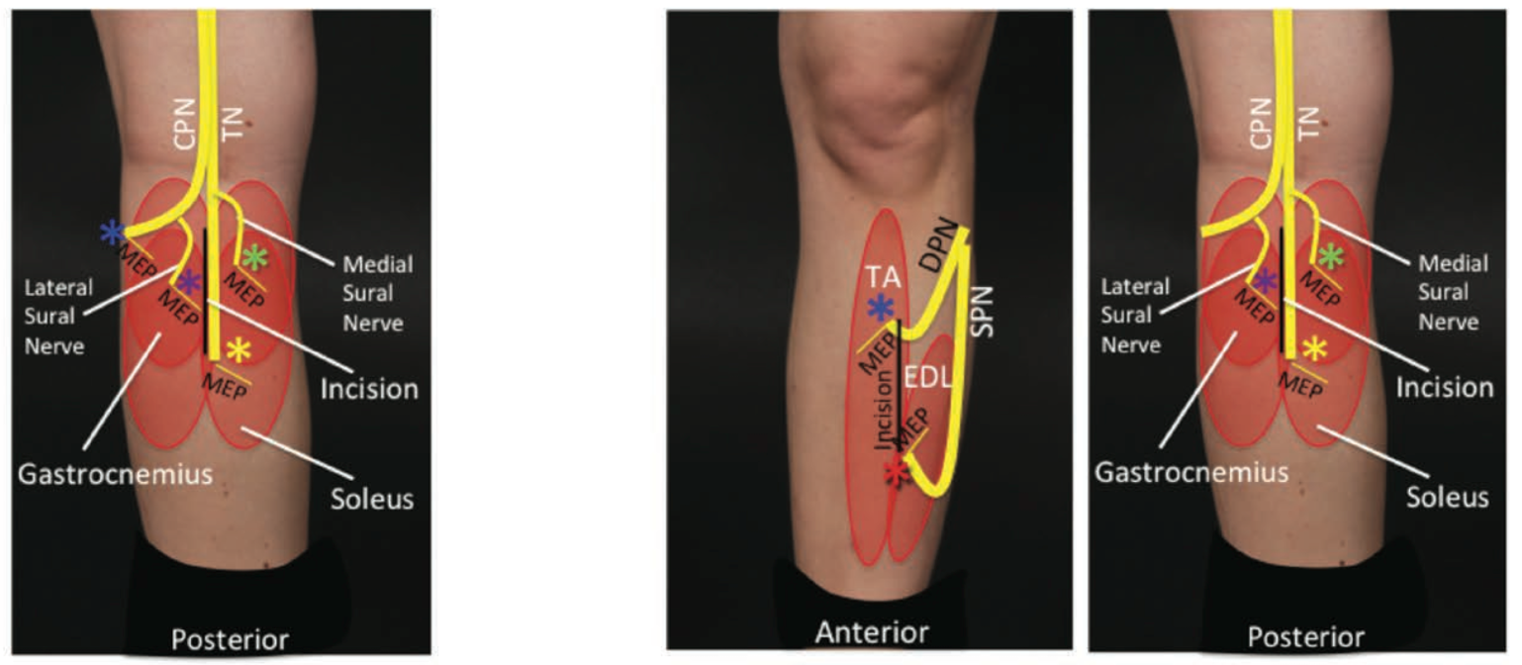
Table 2. BKA delayed (prone, 1-incision approach, posterior midline only)
Nerve | Primary targeted muscles | Lower Leg Compartment
COMMON peroneal, Possible sparing of motor to TA | Lateral gastrocnemius | Superficial posterior
Tibial | Flexor hallucis longus | Deep posterior
Medial sural | Soleus, or Medial gastrocnemius | Superficial posterior
Lateral sural | Lateral gastrocnemius | Superficial posterior
Table 4. AKA (supine to prone; posterior midline, junction of proximal and middle third)
Nerve | Primary targeted muscles
Saphenous | Vastus medialis
Peroneal component of sciatic | Biceps femoris
Tibial component of sciatic | Semitendinosis or Semimembranosis
Posterior femoral cutaneous | Biceps femoris (distal motor branch)

Slide 45
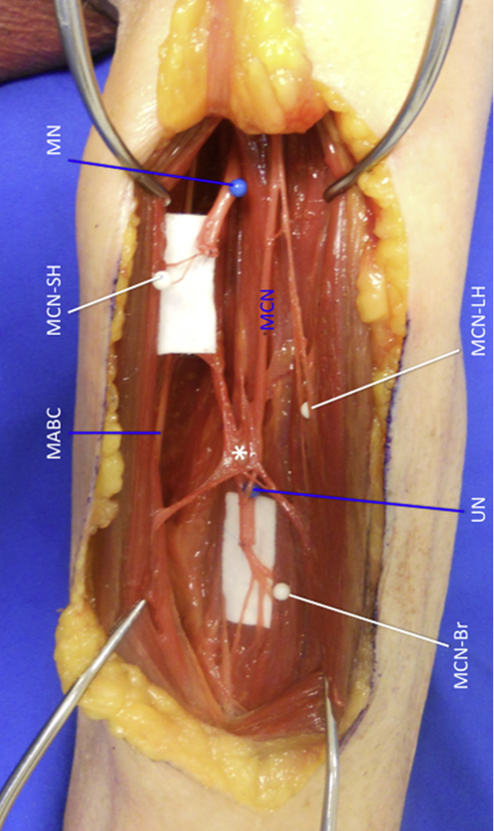
Transhumeral nerve transfers (anterior and posterior midline incisions)
Nerve | Primary targeted muscles
Median | Medial head of biceps
Ulnar | Brachialis
Radial | Lateral head of triceps
MABC/ LABC | Any nearby

Slide 46
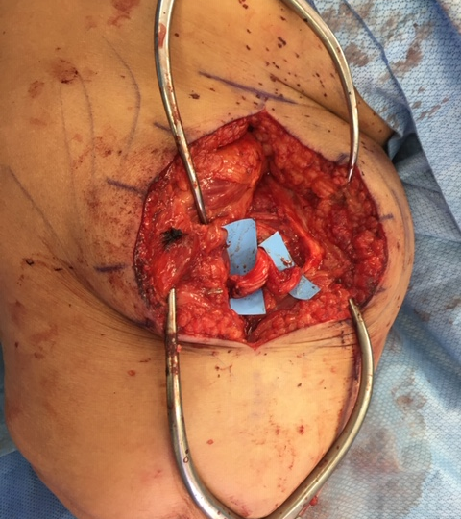

Case 1

Slide 47
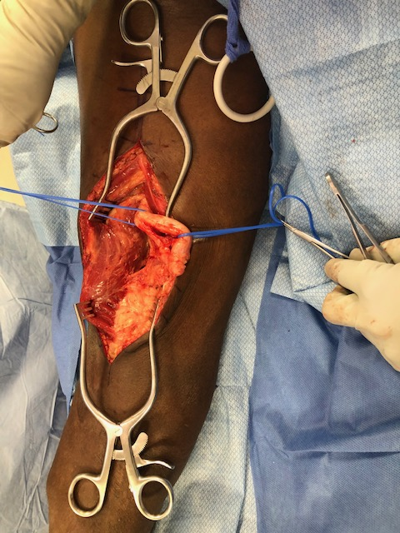
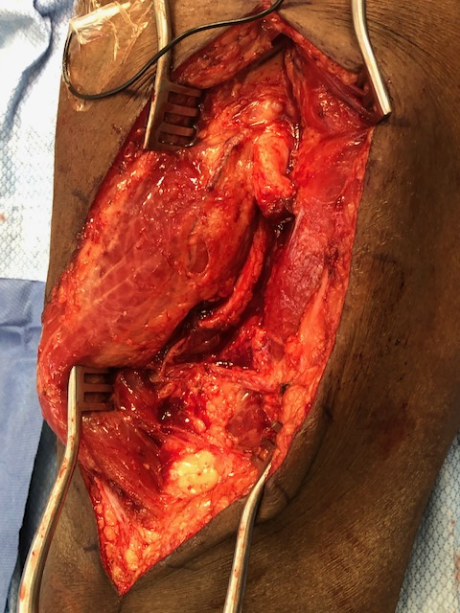
Case 2

Slide 48
TMR
Indications
COntraindications
Almost any end neuroma
Any amputee desiring better prosthetic function
Reduce neuroma pain
Better results in traumatic/oncologic amputees
Age not a contraindication
Can be done acute, subacute, or chronic
    Best to do before chronic pain become centralized ~ 6 mo
    Subacute may be logistically easier
Severe comorbidities
Lack of available target motor fascicles
Diabetic vasculopath (relative)
Chronic limb pain for > 10-20 yrs

Slide 49
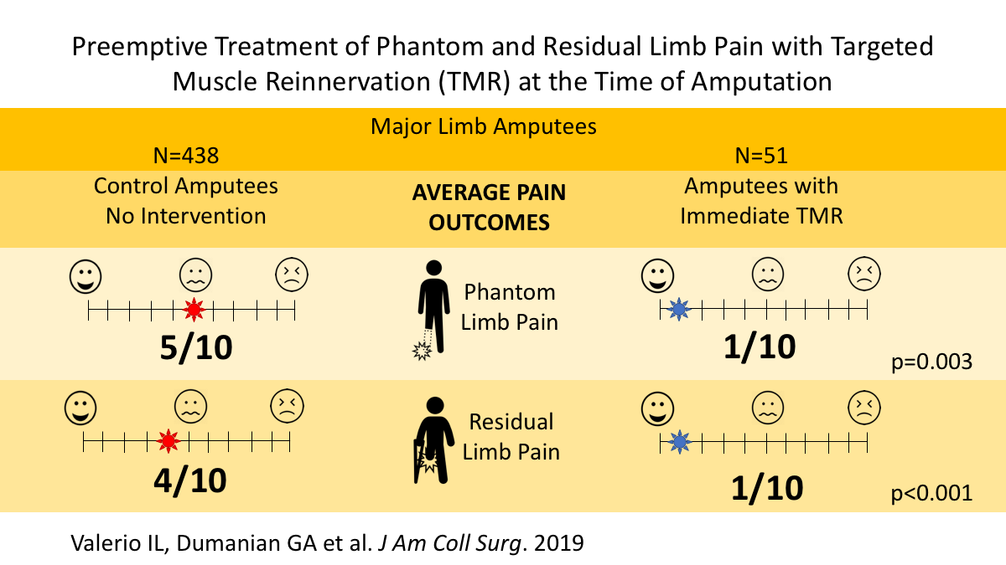
TMR Outcomes
Expect increase in neuropathic or phantom pains for 2-3 months post-op
    Gabapentin, Pregabalin
    Slowly fades over time
Chronic cases - Goal is for improvement, not elimination of neuroma pain
    Increase prosthetic use, decr pain meds, improve function and QOL
Acute TMR at time of amputation reduces the odds of more severe residual limb and phantom limb pain by 3.9 and 3.0-fold, respectively

Slide 50
Regenerativeperipheral nerve interface (rpni)
Cederna - U of Michigan
“Active” technique initially designed to improve intuitive control of myoelectric prosthesis
Animal studies show absence of neuroma formation and clinical studies show decrease in chronic limb pains and phantom limb pins

Slide 51
RPNI
Transected nerve stump placed within free, nonvascularized muscle graft
Graft ~ 30x15x5mm
Nerve secured along axis of muscle fibers
Construct buried remote from surgical incision and away from weight-bearing surface
Larger nerve dissected into fascicular bundles

Slide 52
RPNI
Provides distal physiologic target for axons to make new neuromuscular junctions
    Central feedback loop
    Prevents aberrant axonal growth
Denervated muscle graft becomes regenerated and revascularized with axonal sprouting from implanted nerve
PROS: Easier, no microsurgery
CONS: No target for sensory axons

Slide 53
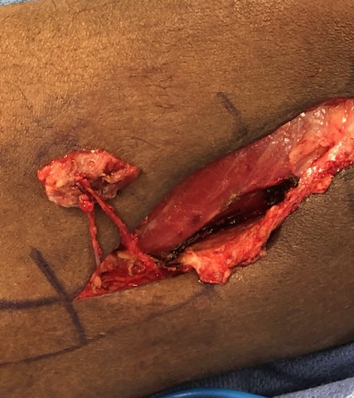
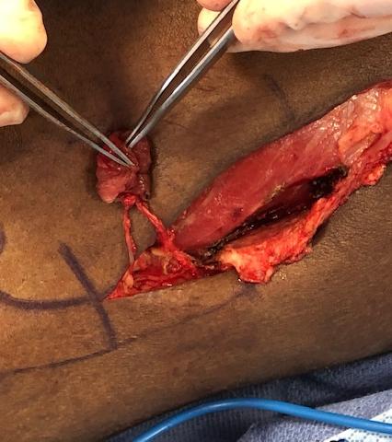
Case 1

Slide 54
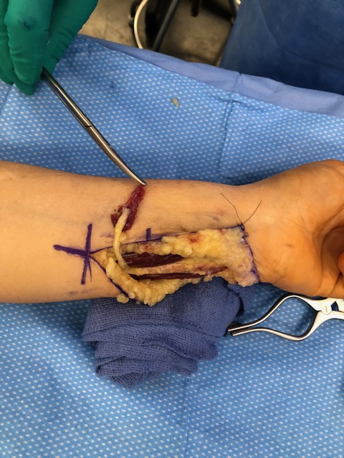
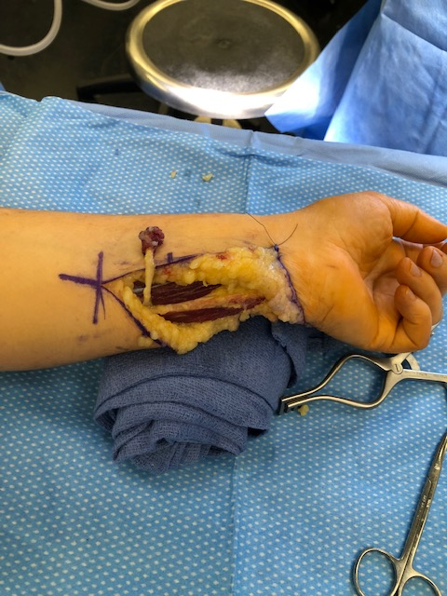
Case 2

Slide 55
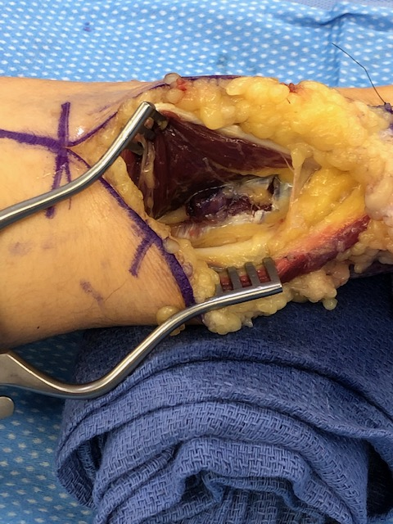
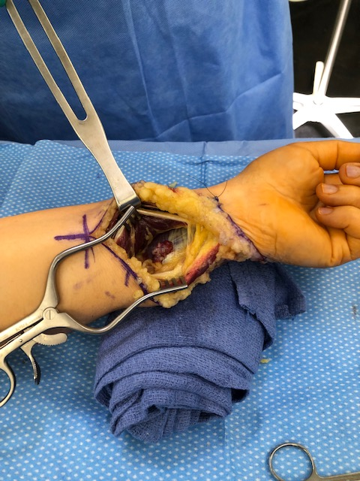
Case 2

Slide 56
Thank YOU

